Slide 1
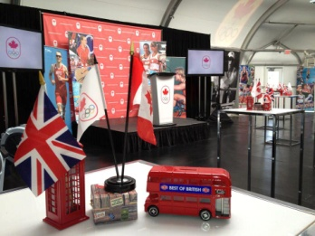
Join ‘British Columbia’s Most Trusted’
Class 1 Truck Driver
Lower Mainland – Delta, BC
Status: Full time (35-40hrs per week)
Remuneration: $26.00 - $30.00 (hourly wage) + Extended Health Benefits
Summary
SW Event Technology is British Columbia’s leading audio visual event services company, with a successful track record of providing high value event support and technical expertise to thousands of events each year. SW was created in 1989 since that time, expanded its operations in western Canada in 1991 with the acquisition of Showtime Event & Display, a leading trade show management and supply agency.
SW Event Technology offers a complete range of audio visual and presentation technology services throughout British Columbia and beyond with multiple branch locations. With over 100 full-time employees and a multi-million dollar inventory, services include audio visual and computer equipment rental, event staging, exhibit and tradeshow solutions, webcasting, presentation management, press conferences and technical coordination for meetings, conventions, corporate events and trade shows
With 3 branches in Kelowna, Vancouver and Victoria, SW Event Technology and Showtime Event & Display are currently seeking a Class 1 Truck Driver to join our thriving Lower Mainland team.
Duties and Responsibilities:
Transport regular inter-branch transfers
Transport event equipment throughout BC and Alberta
Participate in fleet maintenance and inspections
Assist loading and unloading vehicles when required
Assist with warehouse and event site materials handling
*Assist with transportation coordination
Assist with warehouse duties when required
Other duties as required
Qualifications:
Current Class 1 Driver's License with driver’s abstract provided
3+ years class 1 driving experience
High school education or equivalent
Physically fit and able to lift up to 50 lbs
Punctual and reliable
Comfortable working irregular hours
Proficient in driving any class of vehicles from minivans to tractor/trailers
Proficient in driving tractors with standard transmissions
Comfortable driving in all weather conditions
Comfortable driving mountain passes or in dense urban settings
Maintain a professional appearance
Ability to travel throughout the Country
Ability to travel in USA would be an asset
Experience driving forklift is considered an asset
To Apply,
Send your resume and driver’s abstract to:
Jessica Ross
Project/Labour Manager
jross@sw-online.com
We thank all applicants for their interest, however only shortlisted candidates will be contacted
Vancouver - Victoria - Nanaimo - Kelowna - Kamloops - Vernon - Penticton

